Slide 1

Machine Learning in Autonomous Systems
Omar Dinari
Daniele Borgna
Notes:
Hello everyone, thank you for being here! Today, we’re going to talk about Machine Learning in Autonomous Systems.

Slide 2
01
Introduction
Some definitions about the topic
Autonomous systems, DP Watson, DH Scheidt - Johns Hopkins APL technical digest, 2005 - jhuapl.edu https://secwww.jhuapl.edu/techdigest/content/techdigest/pdf/V26-N04/26-04-Watson.pdf
2
Notes:
Omar
In this part we will talk about some definitions about the topic, we will see the definition of Autonomous Systems , We’ll also talk about Machine Learning, which helps these systems to learn from data and improve over time.

Slide 3

Autonomous Systems
Critical Technologies
Definition
Benefits
What is an autonomous system
What are the benefits of AS usage
What are the critical technologies
3
Notes:
Omar
let’s talk about what Autonomous Systems are. These are systems that can work on their own, without needing someone to control them. They make decisions by themselves.
Autonomous systems have big advantages. They help save money and reduce risks because they can work in places where humans can’t go, like deep oceans or outer space. This makes them very useful for things like space missions and exploring the deep sea.

Slide 4
Autonomous Systems : Critical Technologies
Planning and Scheduling: Autonomous systems must establish and adjust plans in real-time, even under changing conditions.
Layered Control: This architecture allows systems to handle events at different timescales, balancing responsiveness and robustness.
Model-Based Reasoning: Autonomous systems use models to estimate system states and make decisions, rather than relying on predefined rule sets.
Reactive Behavior: Systems use real-time control loops to maintain stability, with higher-level reasoning for more complex decisions.
Behavior Coordination: Swarm intelligence and distributed control are key research areas, especially for coordinating multiple autonomous systems toward a common goal.
4
Notes:
Omar
Planning & Scheduling: Systems make and update plans in real-time as conditions change.
Layered Control: Different control levels handle events at different speeds.
Model-Based Reasoning: Uses models to make decisions instead of fixed rules.
Reactive Behavior: Real-time control loops maintain stability.
Behavior Coordination: Enables multiple systems to work together using swarm intelligence.
Swarm Intelligence is a field of artificial intelligence inspired by the behavior of social organisms, such as ants, bees, birds, and fish, that exhibit complex and coordinated behaviors despite having no centralized control.

Slide 5

Autonomous Systems and …
IoT
each machine can automatically and adaptively sense, interconnect, and interact with each other
5
Notes:
Omar
Autonomous Systems use different technologies like IoT, IoT helps machines connect and communicate with each other

Slide 6

Autonomous Systems and …
IoT
each machine can automatically and adaptively sense, interconnect, and interact with each other
Big Data
can support decision-making by giving recommendations and automatically detecting anomalies
6
Notes:
Omar
And use also Big data, Big Data gives information to help them make better decisions.
The 3 V's (volume, velocity and variety) are three defining properties or dimensions of big data. Volume refers to the amount of data, velocity refers to the speed of data processing, and variety refers to the number of types of data.

Slide 7
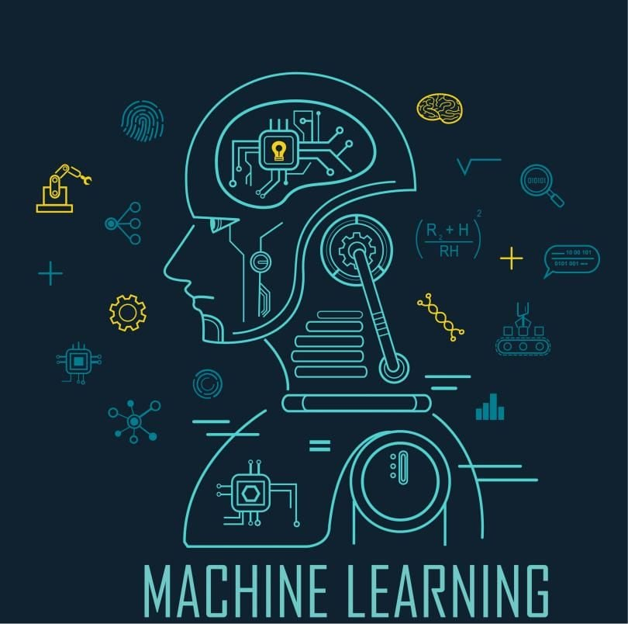
Autonomous Systems and …
IoT
each machine can automatically and adaptively sense, interconnect, and interact with each other
Big Data
can support decision-making by giving recommendations and automatically detecting anomalies
Machine Learning
to realize adaptive autonomous systems, various ML
methods play an important role in discovering knowledge
from observed data
7
Notes:
Omar
And use Machine learning that helps them learn and adapt to new situations.

Slide 8
02
Machine Learning Integration
Machine learning with applications to autonomous systems, X Xu, H He, D Zhao, S Sun, L Busoniu, SX Yang - 2015 https://digitalcommons.uri.edu/cgi/viewcontent.cgi?article=1019&context=ele_facpubs
8
Notes:
Daniele

Slide 9
Potential advantages of ML integration
Easing difficult learning tasks
Addressing sensing problems
Solving
control problems
with some powerful algorithms such as online learning
by specific feature extraction and classification methods
aiming at reinforcement learning methods
9
Notes:
Daniele

Slide 10
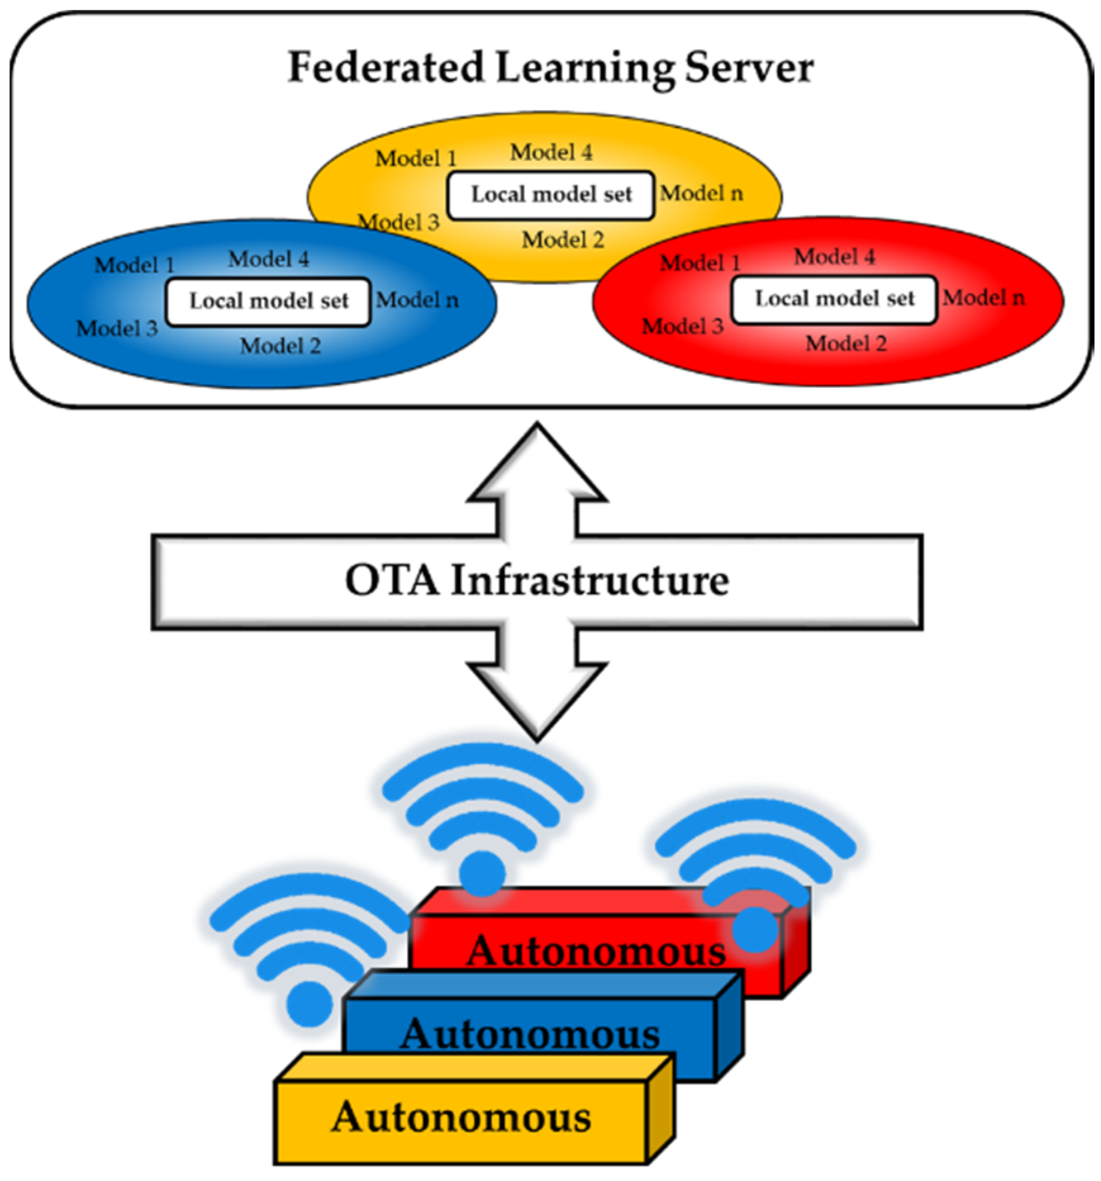
Federated Learning
What is it?
specific kind of ML used in autonomous systems
How it works?
training models across decentralized data sources
Advantages
prioritize confidentiality and privacy, security, compliance and model optimization
10
Notes:
Daniele

Slide 11
03
Safety Assurance
Safety-assured design and adaptation of learning-enabled autonomous systems, Q Zhu, C Huang, R Jiao, S Lan, H Liang, X Liu… - Proceedings of the 26th …, 2021 - dl.acm.org - https://dl.acm.org/doi/pdf/10.1145/3394885.3431623
11
Notes:
Omar

Slide 12
Why is safety important?
01
02
Dynamicity
Attacks
Dynamic and uncertain environment could lead to unexpected results
Interferences, faults and attacks may disturb the normale execution
12
Notes:
Omar
Safety is very important for Autonomous Systems. If they are not safe, they could have problems from errors, interruptions, or even attacks. For example, in self-driving cars, safety is critical because any problem could lead to accidents.

Slide 13
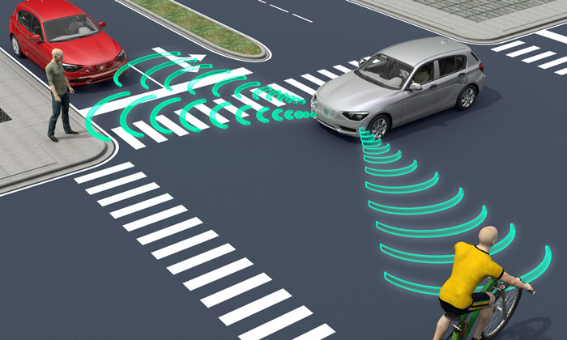
Example: Connected and Autonomous Vehicles (CAVs)
13
Notes:
Omar
In this image we have selfdriving cars as an example. These vehicles face many uncertainties, like sensor errors or communication problems, which could cause accidents.

Slide 14
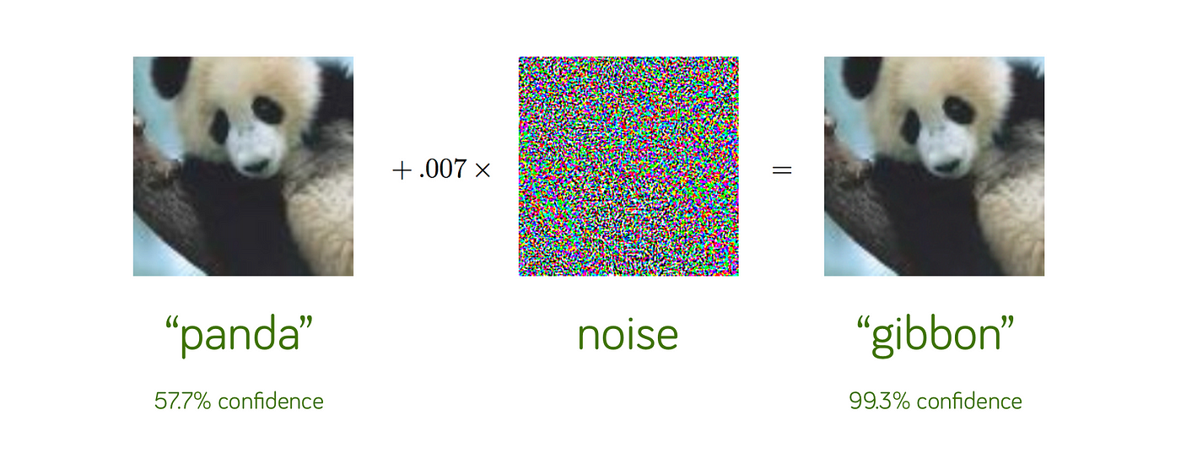
Safety problems: adversarial attacks
An adversarial attack is a small but intentional change in an image that lead to a misclassification.
14
Notes:
Omar.
There are two big safety problems here. One is called ‘adversarial attacks,’ where small changes in data can confuse the system.

Slide 15

Safety problems: timing safety
The model should work not only well but also fast, specially in real time systems like autonomous cars.
15
Notes:
Omar
Another is ‘timing safety,’ which means that the system has to respond very quickly, especially for things like self-driving cars.

Slide 16
04
Safety Assurance: AMLAS
Guidance on the assurance of machine learning in autonomous systems (AMLAS), R Hawkins, C Paterson, C Picardi, Y Jia… - arXiv preprint arXiv …, 2021 - arxiv.org - https://arxiv.org/pdf/2102.01564
16
Notes:
Daniele

Slide 17
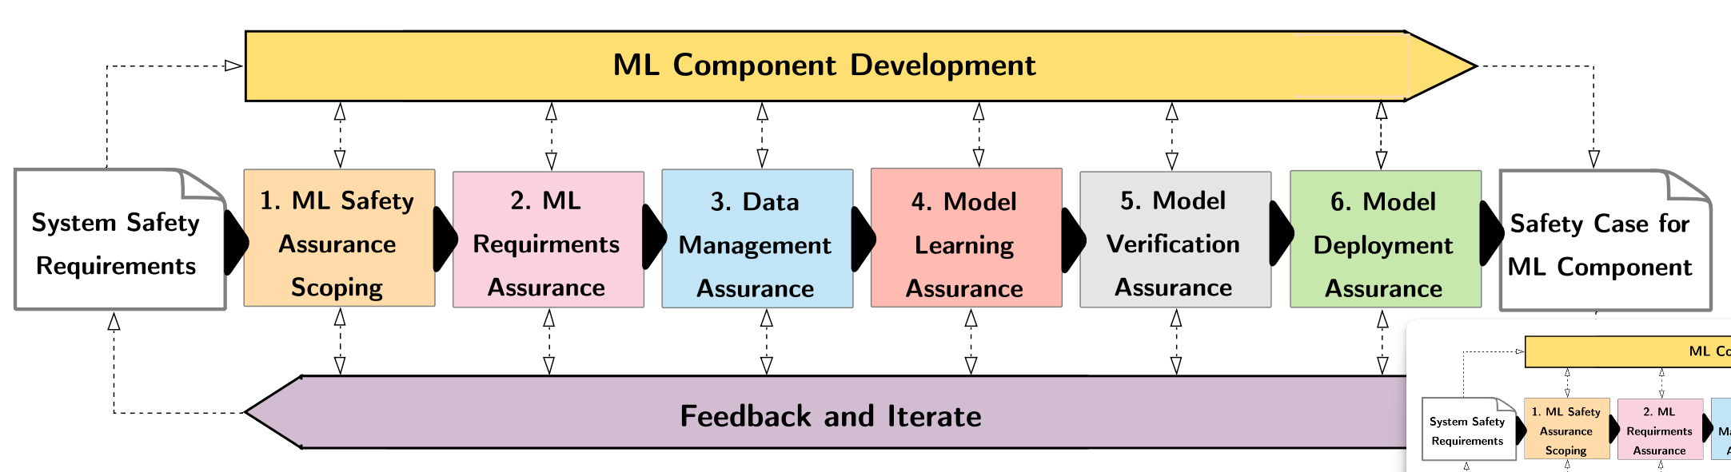
AMLAS: introduction
Definition
Structure
Assurance of Machine Learning for Autonomous Systems
Six stages and artifacts
17
Notes:
Daniele
Specified methodology for:
sistematically integrating safety assurance into ML components of an AS
generating the evidence base to explicitly justify the acceptable safety of ML components in AS

Slide 18
AMLAS: stages overview
Stage 1
ML Safety Assurance Scoping
Stage 2
ML Safety Requirements Elicitation
Stage 3
Data Management
Stage 4
Model Learning
Stage 5
Model Verification
Stage 6
Model Deployment
18
Notes:
Daniele
In this stage are identified system-level safety requirements and the role of ML components in the whole system.

Slide 19
AMLAS: stages overview
Stage 1
ML Safety Assurance Scoping
Stage 2
ML Safety Requirements Elicitation
Stage 3
Data Management
Stage 4
Model Learning
Stage 5
Model Verification
Stage 6
Model Deployment
19
Notes:
Daniele
In this phase, specific safety requirements for the ML component are identified and linked with the ones for the entire system. That ensure a traceability between the whole system requirements and the specific components ones.

Slide 20
AMLAS: stages overview
Stage 1
ML Safety Assurance Scoping
Stage 2
ML Safety Requirements Elicitation
Stage 3
Data Management
Stage 4
Model Learning
Stage 5
Model Verification
Stage 6
Model Deployment
20
Notes:
Daniele
In this stage we ensure that the data used for training and validating the ML model is appropriate and sufficient.

Slide 21
AMLAS: stages overview
Stage 1
ML Safety Assurance Scoping
Stage 2
ML Safety Requirements Elicitation
Stage 3
Data Management
Stage 4
Model Learning
Stage 5
Model Verification
Stage 6
Model Deployment
21
Notes:
Daniele
Here the ML model is developed and trained using the prepared data, implementing best practices to performs safety requirements defined in the previous stages.

Slide 22
AMLAS: stages overview
Stage 1
ML Safety Assurance Scoping
Stage 2
ML Safety Requirements Elicitation
Stage 3
Data Management
Stage 4
Model Learning
Stage 5
Model Verification
Stage 6
Model Deployment
22
Notes:
Daniele
This phase involves evaluating and confirming that the ML model meets the established safety requirements and also the model's performance, robustness, and behavior under various conditions to ensure it operates safely and as intended.

Slide 23
AMLAS: stages overview
Stage 1
ML Safety Assurance Scoping
Stage 2
ML Safety Requirements Elicitation
Stage 3
Data Management
Stage 4
Model Learning
Stage 5
Model Verification
Stage 6
Model Deployment
23
Notes:
Daniele
Here the ML model is integrated into the autonomous system ensuring that the integration maintains system safety and that the ML component functions correctly

Slide 24
Conclusion
Points
covered
Future
focus
Autonomous systems and Machine Learning, Federated Learning, Safety converns.
Further research in safety assurance, real-time performance, and robust ML integration.
24
Notes:
Omar
To finish, Machine Learning is important for making Autonomous Systems more useful. But safety is also important to prevent problems. AMLAS is a great method to keep these systems safe and reliable.
In the future, we need to focus on making autonomous systems safer, faster, and better at learning. This work will help create machines that can work better and more safely on their own.

Slide 25
Thanks!
Omar Dinari
Daniele Borgna
25

Slide 26
References
1. Machine learning with applications to autonomous systems, X Xu, H He, D Zhao, S Sun, L Busoniu, SX Yang - 2015 - https://digitalcommons.uri.edu/cgi/viewcontent.cgi?article=1019&context=ele_facpubs
2. Guidance on the assurance of machine learning in autonomous systems (AMLAS), R Hawkins, C Paterson, C Picardi, Y Jia… - arXiv preprint arXiv …, 2021 - arxiv.org - https://arxiv.org/pdf/2102.01564
3. Safety-assured design and adaptation of learning-enabled autonomous systems, Q Zhu, C Huang, R Jiao, S Lan, H Liang, X Liu… - Proceedings of the 26th …, 2021 - dl.acm.org - https://dl.acm.org/doi/pdf/10.1145/3394885.3431623
4. Integrations between autonomous systems and modern computing techniques: a mini review, J Chen, M Abbod, JS Shieh - Sensors, 2019 - mdpi.com - https://www.mdpi.com/1424-8220/19/18/3897
5. Autonomous systems, DP Watson, DH Scheidt - Johns Hopkins APL technical digest, 2005 - jhuapl.edu - https://secwww.jhuapl.edu/techdigest/content/techdigest/pdf/V26-N04/26-04-Watson.pdf
26

